Slide 1
Model Robust Verification (1) Deterministic Approach

Slide 2
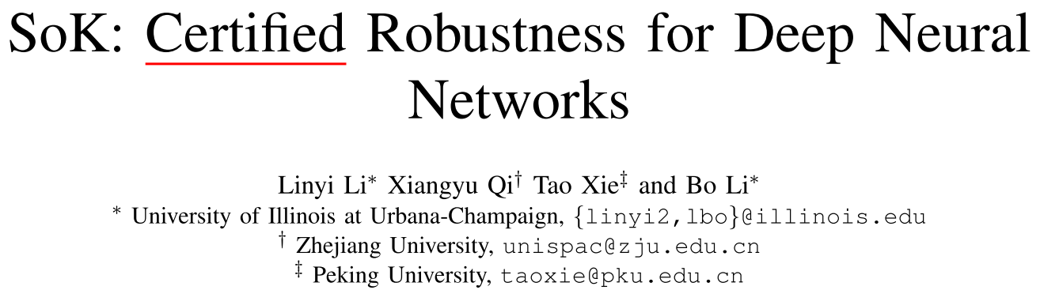
待更新
更新论文信息
Title | SoK: Certified Robustness for Deep Neural Networks
Arxiv | https://arxiv.org/abs/2009.04131
Github | https://github.com/AI-secure/VeriGauge https://github.com/AI-secure/Provable-Training-and-Verification-Approaches-Towards-Robust-Neural-Networks

Slide 3
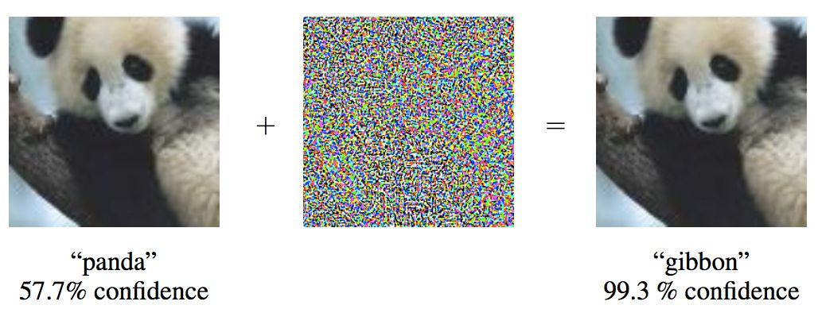
Overview
What is the Adversarial Samples?

Slide 4
Overview
How to defend against the adversarial samples?
Based on Detection and Preprocessing
Training a Detection Neural Network
Feature Distillation
… …
Based on Model Robustness Enhancement
Adversarial Training
Model Distillation
… …

Slide 5
Overview
How to defend against the adversarial samples?
Based on Robustness Verification
Robust
Not Robust

Slide 6
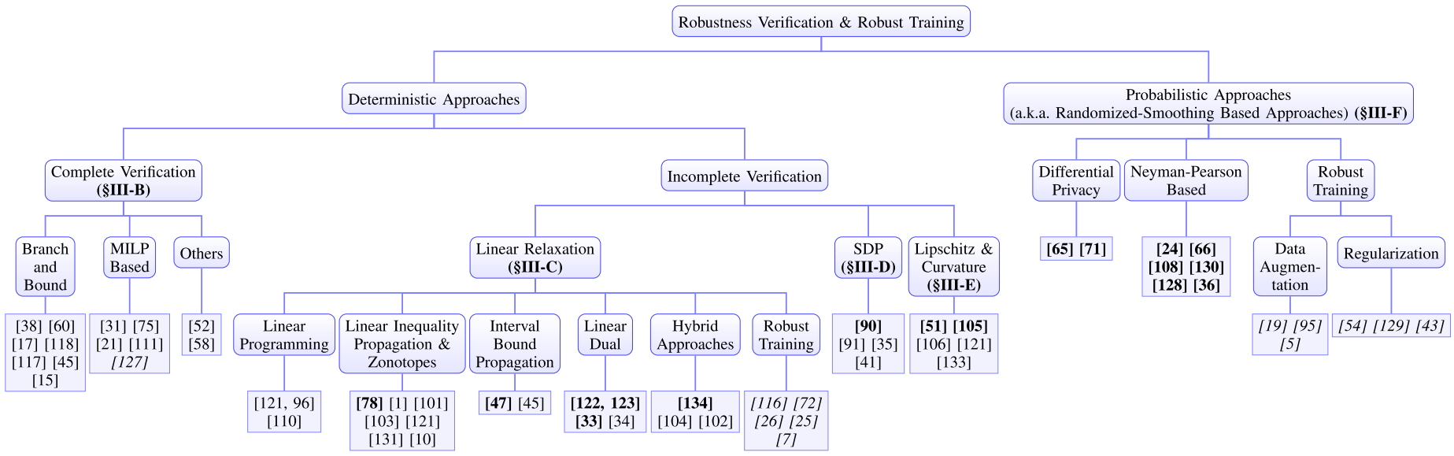
Overview
How to defend against the adversarial samples?
Based on Robustness Verification

Slide 7
Notations and Preliminaries
We mainly focus on existing works on the classification task with neural networks, and mostly is feed-forward ReLU networks.
The region of adversarial perturbation
Transfer verification problem to an Optimization Problem:

Slide 8
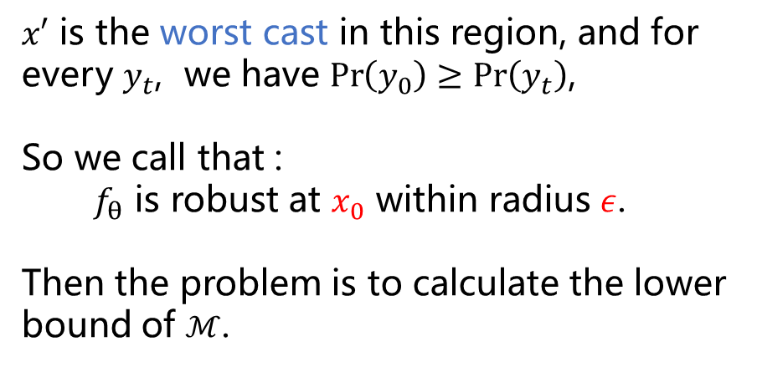
Notations and Preliminaries
$x′$ is the worst cast in this region, and for every $y_{t}$, we have $\operatorname{Pr}\left(y_{0}\right)≥\operatorname{Pr}\left(y_{t}\right)$,
So we call that :
$f_{θ}$ is robust at $x_{0}$ within radius $ε$.
Then the problem is to calculate the lower bound of $ℳ$.

Slide 9
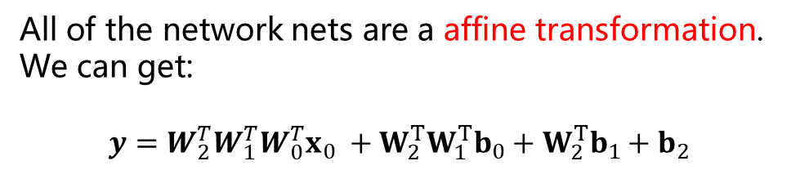
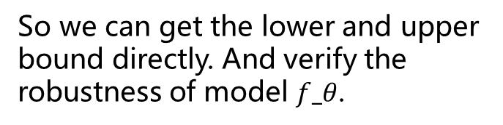
Notations and Preliminaries
Why this problem so difficult?
Given an example:
So we can get the lower and upper bound directly. And verify the robustness of model $f_θ$.
Input Layer
Hidden Layer 1
Hidden Layer 2
Output Layer
All of the network nets are a affine transformation.
We can get:
$$y=W_{2}^{T}W_{1}^{T}W_{0}^{T}x_{0} +W_{2}^{T}W_{1}^{T}b_{0}+W_{2}^{T}b_{1}+b_{2}$$

Slide 10
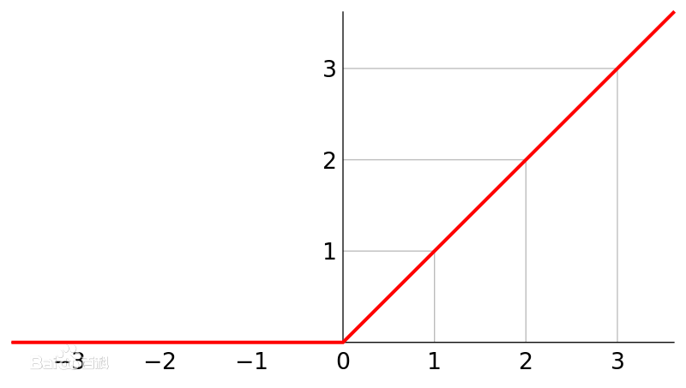
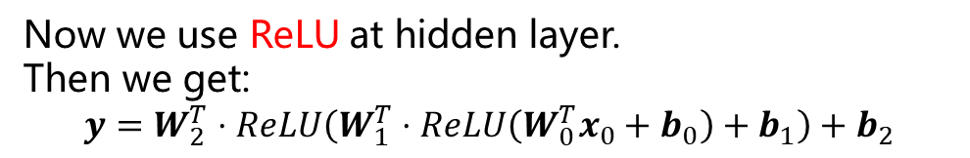
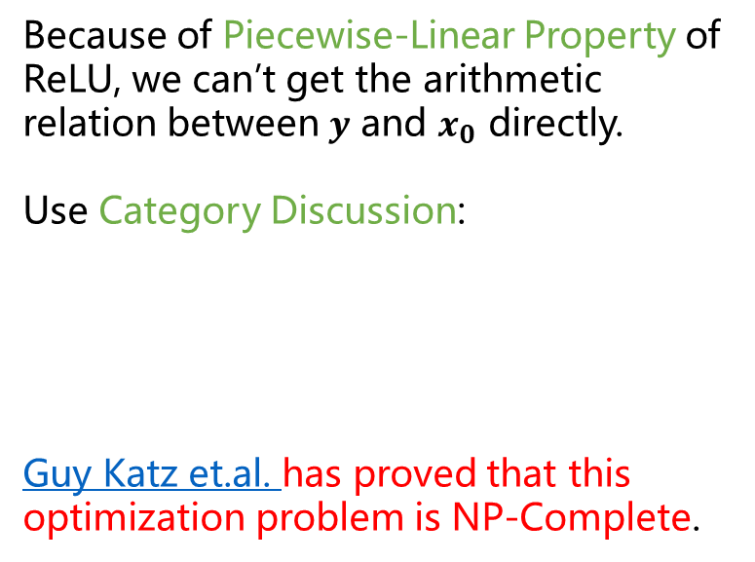
Notations and Preliminaries
Why this problem so difficult?
ReLU
Because of Piecewise-Linear Property of ReLU, we can’t get the arithmetic relation between $y$ and $x_{0}$ directly.
Use Category Discussion:
Guy Katz et.al. has proved that this optimization problem is NP-Complete.
Input Layer
Hidden Layer 1
Hidden Layer 2
Output Layer
Now we use ReLU at hidden layer.
Then we get:
$$y=W_{2}^{T}⋅ReLU\left(W_{1}^{T}⋅ReLU\left(W_{0}^{T}x_{0}+b_{0}\right)+b_{1}\right)+b_{2}$$

Slide 11
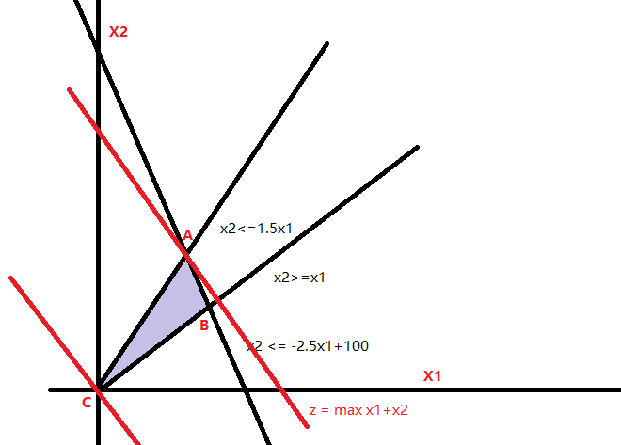
Notations and Preliminaries
What is Linear Programming?
Linear programming is an optimization technique for a system of linear constraints and a linear objective function.
How to solve?
https://www.jianshu.com/p/a0fc8a57f452
https://brilliant.org/wiki/linear-programming
These two questions look similar.

Slide 12
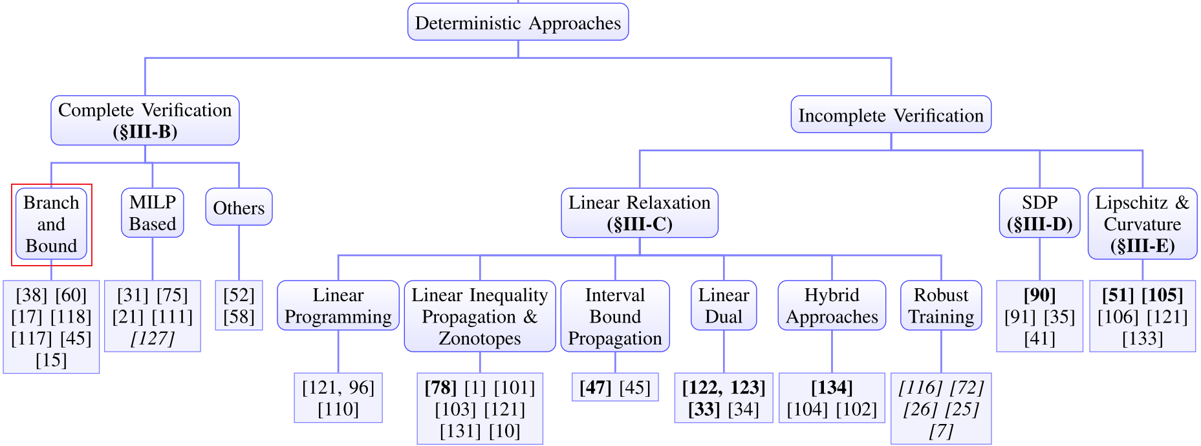
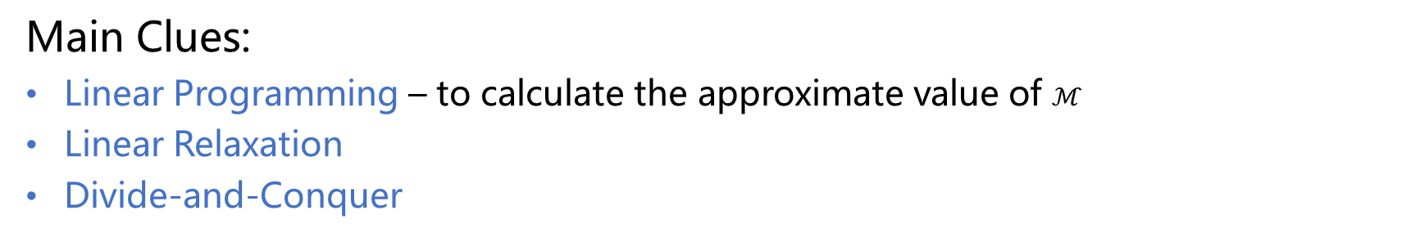
Branch-and-Bound
Main Clues:
Linear Programming – to calculate the approximate value of $ℳ$
Linear Relaxation
Divide-and-Conquer

Slide 13
Branch-and-Bound - Linear Programming
Input Layer
Hidden Layer 1
Hidden Layer 2
Output Layer
Constraint 1: (Inequality Constraints)
The boundary of input perturbation.

Slide 14
Branch-and-Bound - Linear Programming
Input Layer
Hidden Layer 1
Hidden Layer 2
Output Layer
Constraint 2: (Equality Constraints)
The Affine transformation between neurons.

Slide 15
Branch-and-Bound - Linear Programming
ReLU function has piecewise linear property.
Input Layer
Hidden Layer 1
Hidden Layer 2
Output Layer
Constraint 3: (Inequality Constraints)
The ReLU function.

Slide 16
Branch-and-Bound - Linear Programming
ReLU function has piecewise linear property.
Constraint 3: (Inequality Constraints)
The ReLU function.
Input Layer
Hidden Layer 1
Hidden Layer 2
Output Layer
Take neuron $x_{1,0}$ for example, we can list both cases according to whether $x_{1,0}$ is greater than $0$:

Slide 17
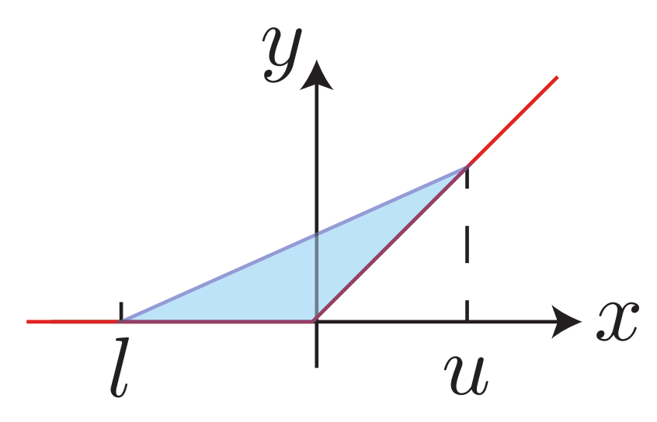
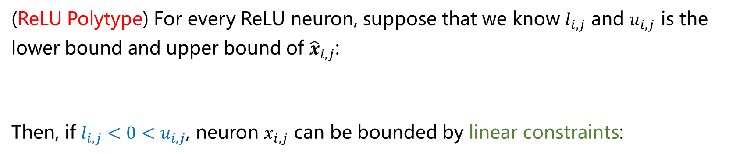
Branch-and-Bound - Linear Relaxation
We have to solve about $2^{n}$ Linear Programming problems, can we simplify?
(ReLU Polytype) For every ReLU neuron, suppose that we know $l_{i,j}$ and $u_{i,j}$ is the lower bound and upper bound of ${\hat{x}}_{i,j}$:
Then, if $l_{i,j}<0<u_{i,j}$, neuron $x_{i,j}$ can be bounded by linear constraints:

Slide 18
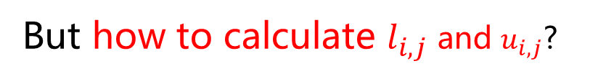
Branch-and-Bound - Linear Relaxation
But how to calculate $l_{i,j}$ and $u_{i,j}$?

Slide 19
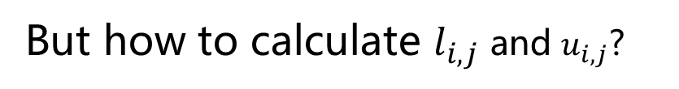
Branch-and-Bound - Linear Relaxation
But how to calculate $l_{i,j}$ and $u_{i,j}$?
Input Layer
Hidden Layer 1
Hidden Layer 2
Output Layer
In affine transformation, we can calculate this bound easily. But in ReLU network, we can not handler the mathematical relations among layers.

Slide 20
Branch-and-Bound - Linear Relaxation
Only the input interval is considered:
Example:
We know:
Extracted bounds:

Slide 21
Branch-and-Bound - Linear Relaxation
Only the input interval is considered:
Example:
We know:
Extracted bounds:

Slide 22
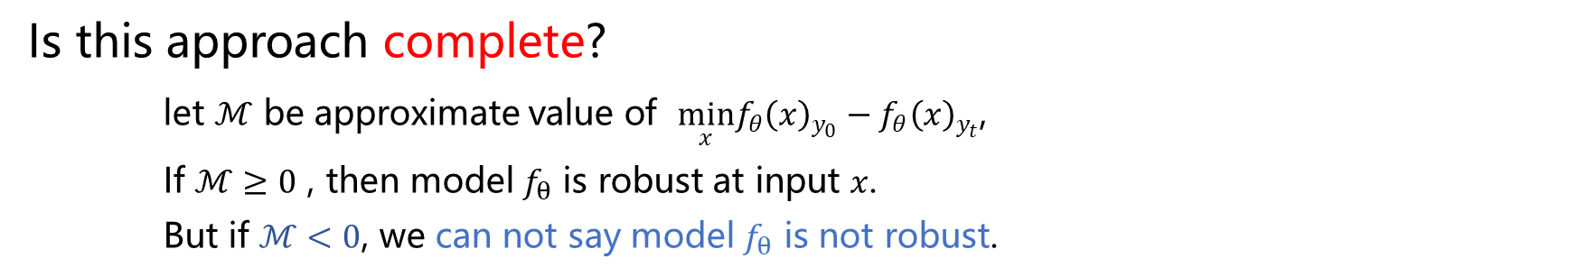
Branch-and-Bound - Divide-and-Conquer
Is this approach complete?
let $ℳ$ be approximate value of $\min_{x}f_{θ}{\left(x\right)}_{y_{0}}−f_{θ}{\left(x\right)}_{y_{t}}$,
If $ℳ≥0$ , then model $f_{θ}$ is robust at input $x$.
But if $ℳ<0$, we can not say model $f_{θ}$ is not robust.

Slide 23
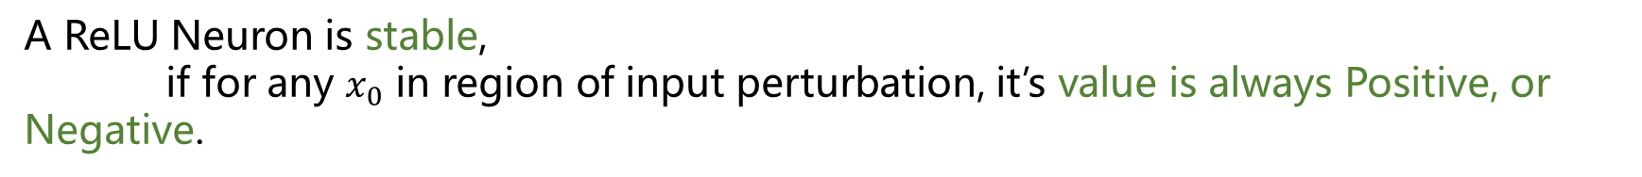
Branch-and-Bound - Divide-and-Conquer
When we get $ℳ<0$
Normal Neuron
Unstable ReLU Neuron
Stable ReLU Neuron
Input Layer
Hidden Layer 1
Hidden Layer 2
Output Layer
A ReLU Neuron is stable,
if for any $x_{0}$ in region of input perturbation, it’s value is always Positive, or Negative.

Slide 24
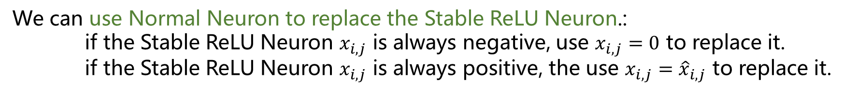
Branch-and-Bound - Divide-and-Conquer
When we get $ℳ<0$
Normal Neuron
Unstable ReLU Neuron
Stable ReLU Neuron
Input Layer
Hidden Layer 1
Hidden Layer 2
Output Layer
We can use Normal Neuron to replace the Stable ReLU Neuron.:
if the Stable ReLU Neuron $x_{i,j}$ is always negative, use $x_{i,j}=0$ to replace it.
if the Stable ReLU Neuron $x_{i,j}$ is always positive, the use $x_{i,j}={\hat{x}}_{i,j}$ to replace it.

Slide 25
Branch-and-Bound - Divide-and-Conquer
When we get $ℳ<0$
Normal Neuron
Unstable ReLU Neuron
Stable ReLU Neuron
Input Layer
Hidden Layer 1
Hidden Layer 2
Output Layer
We can use Normal Neuron to replace the Stable ReLU Neuron.:
if the Stable ReLU Neuron $x_{i,j}$ is always negative, use $x_{i,j}=0$ to replace it.
if the Stable ReLU Neuron $x_{i,j}$ is always positive, the use $x_{i,j}={\hat{x}}_{i,j}$ to replace it.

Slide 26
Branch-and-Bound - Divide-and-Conquer
When we get $ℳ<0$
Normal Neuron
Unstable ReLU Neuron
Stable ReLU Neuron
Input Layer
Hidden Layer 1
Hidden Layer 2
Output Layer
To get a more tighter lower bound, split the Unstable ReLU Neuron into two versions: always negative or always positive.

Slide 27
Branch-and-Bound - Divide-and-Conquer
To get a more tighter lower bound, split the Unstable ReLU Neuron into two versions: always negative or always positive. (Back to the beginning)
Input Layer
Hidden Layer 1
Hidden Layer 2
Output Layer
Input Layer
Hidden Layer 1
Hidden Layer 2
Output Layer

Slide 28
Branch-and-Bound - Divide-and-Conquer
When can we say that the model is not robust?
Input Layer
Hidden Layer 1
Hidden Layer 2
Output Layer
Input Layer
Hidden Layer 1
Hidden Layer 2
Output Layer

Slide 29
Branch-and-Bound - Divide-and-Conquer
Complete? Yes!
Input Layer
Hidden Layer 1
Hidden Layer 2
Output Layer
Input Layer
Hidden Layer 1
Hidden Layer 2
Output Layer

Slide 30
Branch-and-Bound
Advantage:
We can know whether it is robust or not early.
More to do:
Apply with a fast Linear Programming Solver.
Apply with a good ReLU Splitter.
Any question above? /(ㄒoㄒ)/~~
All beginnings are hard. Fortunately, the latter is easy to understand.

Slide 31
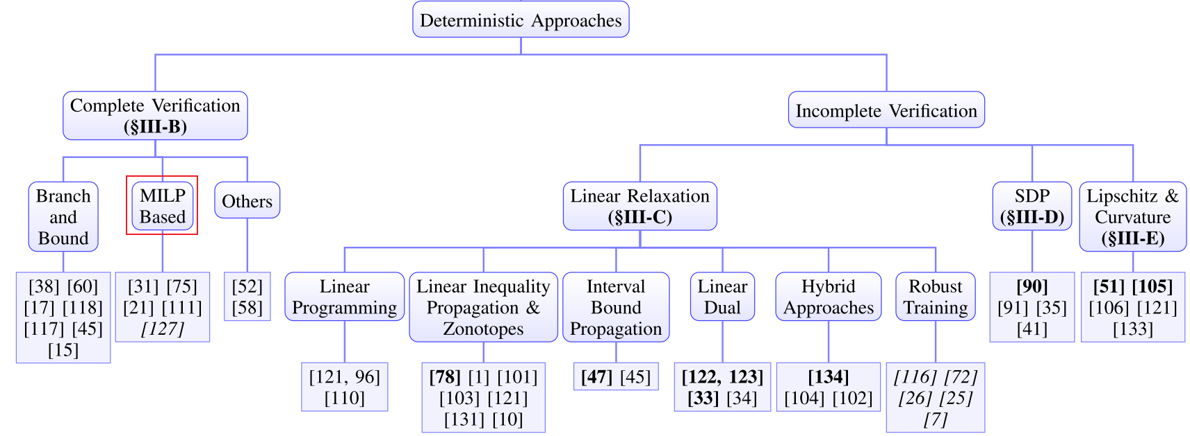
MILP-Based Approaches
Main Clues:
Mixed Integer Linear Programming – Some value must be an integer.

Slide 32
MILP-Based Approaches
Review the Linear Programming part of Branch-and-Bound:
Can we use a bool value to stand the different state of ReLU Neuron?

Slide 33
MILP-Based Approaches
Can we use a bool value to stand the different state of ReLU Neuron?
If $a_{i,j}=0$, then we have
If $a_{i,j}=1$, then we have
Where $M_{i,j}=max⁡(\left|l_{i,j}\right|, \left|u_{i,j}\right|)$, and it’s used to prevent conflict between the above two groups of inequalities.

Slide 34
MILP-Based Approaches
Put it together

Slide 35
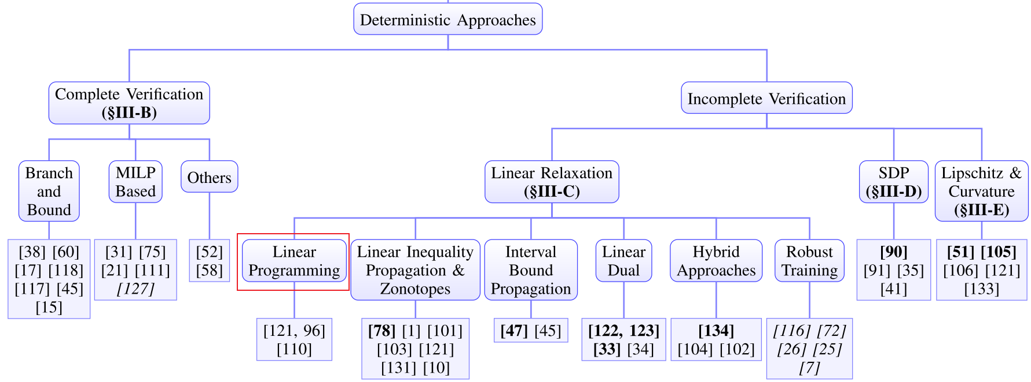
Linear Programming

Slide 36
Branch-and-Bound - Divide-and-Conquer
Is this approach complete?
let $ℳ$ be approximate value of $\min_{x}f_{θ}{\left(x\right)}_{y_{0}}−f_{θ}{\left(x\right)}_{y_{t}}$,
If $ℳ≥0$ , then model $f_{θ}$ is robust at input $x$.
But if $ℳ<0$, we can not say model $f_{θ}$ is not robust.

Slide 37
Linear Programming
Branch-and-Bound without “divide-and-conquer”. So it’s a incomplete approach.

Slide 38
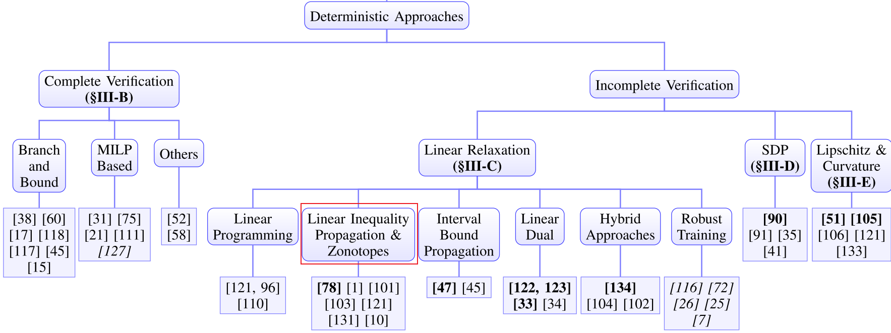
Linear Inequality Propagation & Zonotopes
Main Clues:
Use only one inequality to stand the lower bound / Use a parallelogram region
The linear bounds can be propagated through the layers instead of solving LP problem

Slide 39
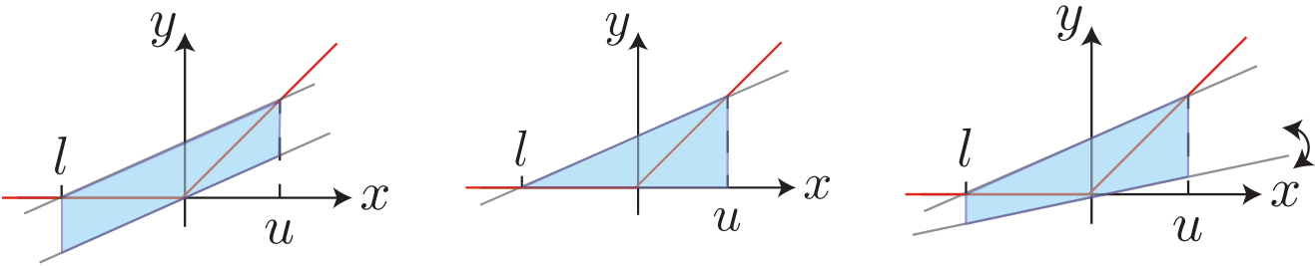
Linear Inequality Propagation - only one inequality
First, Using only one inequality to stand the lower bound:

Slide 40
Linear Inequality Propagation – propagate bound
We maintain the linear bound for any $x∈B_{p,ε}\left(x_{0}\right)$:
Next layer, we can deduct the bound after affine mapping ${\hat{x}}_{k+1}=W_{k}^{T}x_{k}+b_{k}$:
Using a sample to understand
Linear Programming is not needed.
Then, we can compute the activation value bound $l_{k+1}$ and $u_{k+1}$ for ${\hat{x}}_{k+1}$, and compute the linear bound for $x_{k+1}$:

Slide 41
Linear Inequality Propagation – propagate bound

Slide 42
Linear Inequality Propagation – propagate bound
We maintain the linear bound for any $x∈B_{p,ε}\left(x_{0}\right)$:
Next layer, we can deduct the bound after affine mapping ${\hat{x}}_{k+1}=W_{k}^{T}x_{k}+b_{k}$:
Linear Programming is not needed.
Then, we can compute the activation value bound $l_{k+1}$ and $u_{k+1}$ for ${\hat{x}}_{k+1}$, and compute the linear bound for $x_{k+1}$:

Slide 43
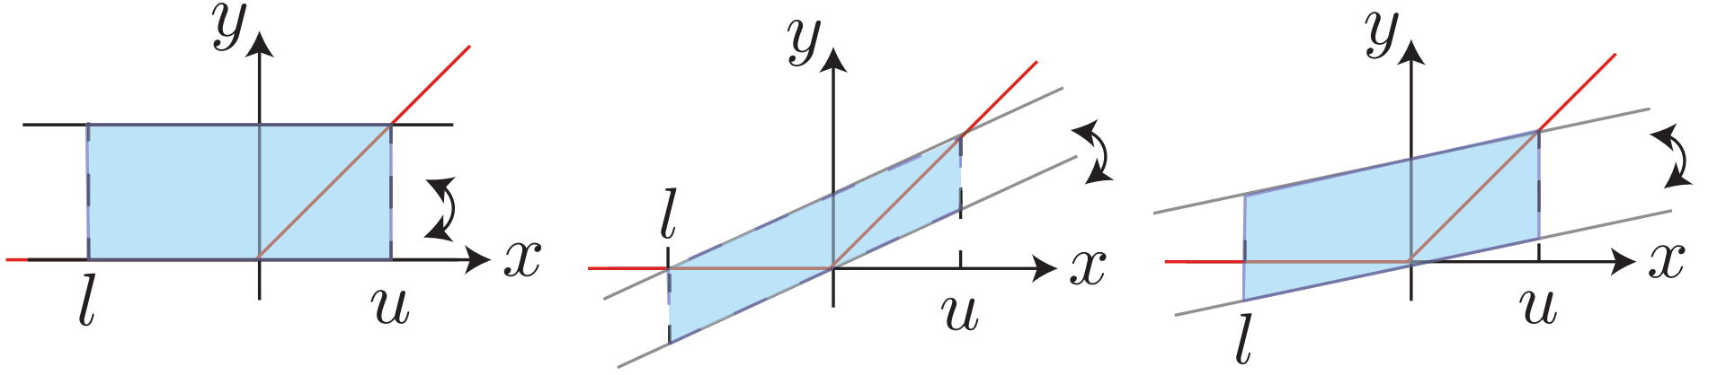
Zonotopes – parallelogram bound
Using a parallelogram bound:
Compute the activation value bound $l_{k+1}$ and $u_{k+1}$ for ${\hat{x}}_{k+1}$, and compute the linear bound for $x_{k+1}$:
Same as pre

Slide 44
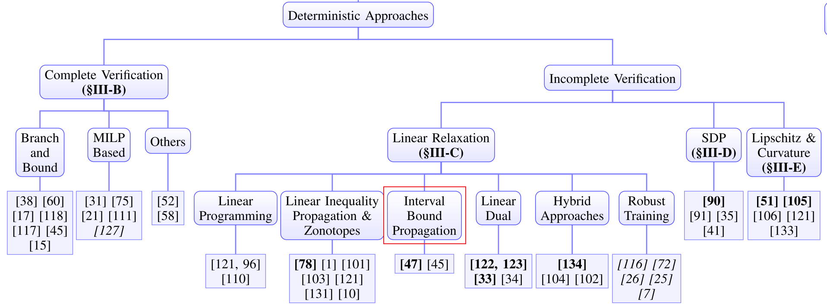
Interval Bound Propagation
Main Clues:
Propagate the bound interval

Slide 45
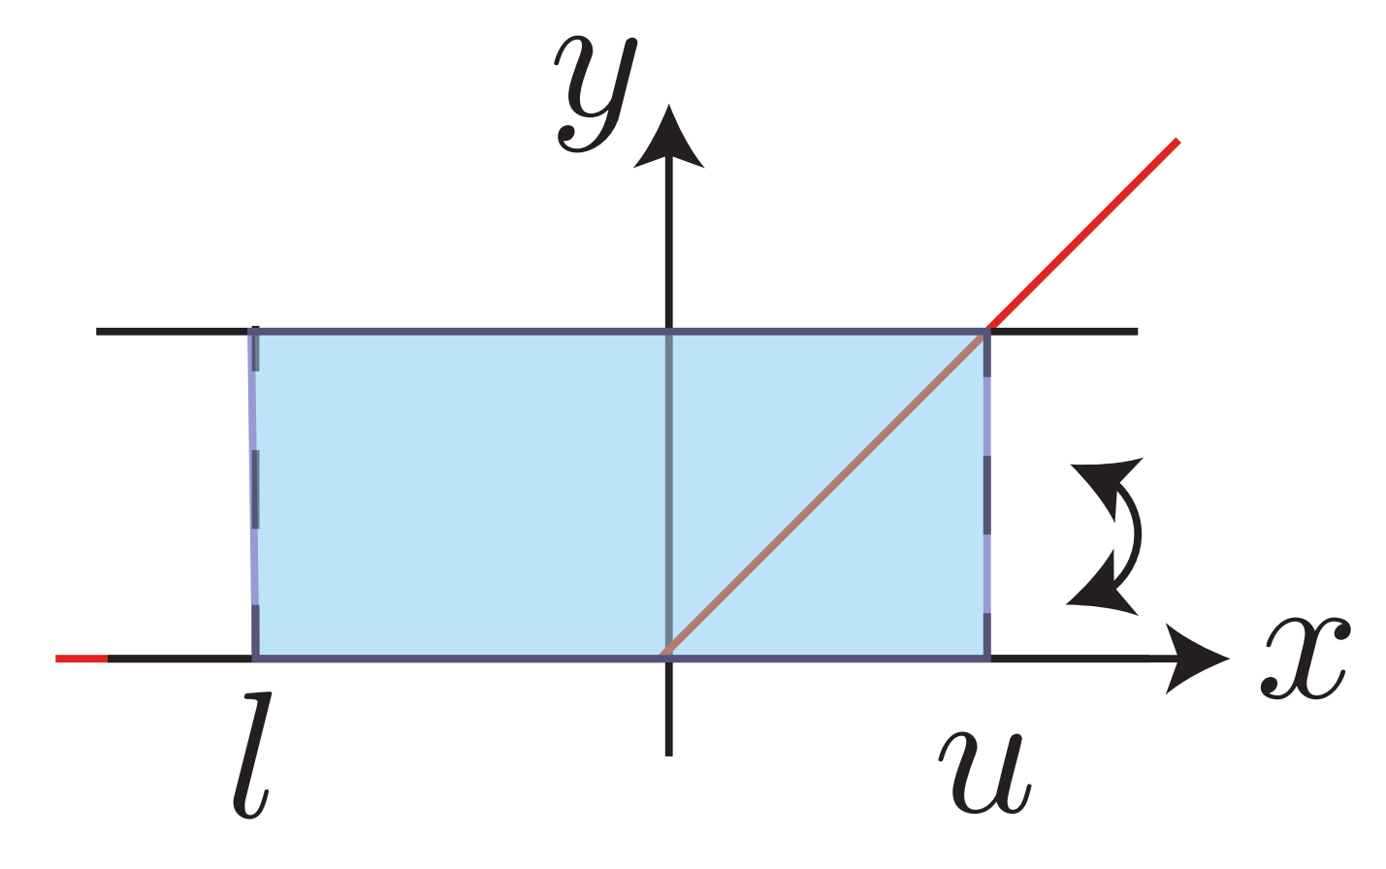
Interval Bound Propagation
The linear relaxation in IBP:
We maintain the linear bound for any $x∈B_{p,ε}\left(x_{0}\right)$:
We can deduct the bound after affine mapping ${\hat{x}}_{k+1}=W_{k}^{T}x_{k}+b_{k}$:

Slide 46
Interval Bound Propagation
The linear relaxation in IBP:
We maintain the linear bound for any $x∈B_{p,ε}\left(x_{0}\right)$:
We can deduct the bound after affine mapping ${\hat{x}}_{k+1}=W_{k}^{T}x_{k}+b_{k}$:

Slide 47
Interval Bound Propagation
What’s the difference between Linear Inequality Propagation and Interval Bound Propagation?
Linear Inequality Propagation

Slide 48
Interval Bound Propagation
What’s the difference between Linear Inequality Propagation and Interval Bound Propagation?
Interval Bound Propagation

Slide 49
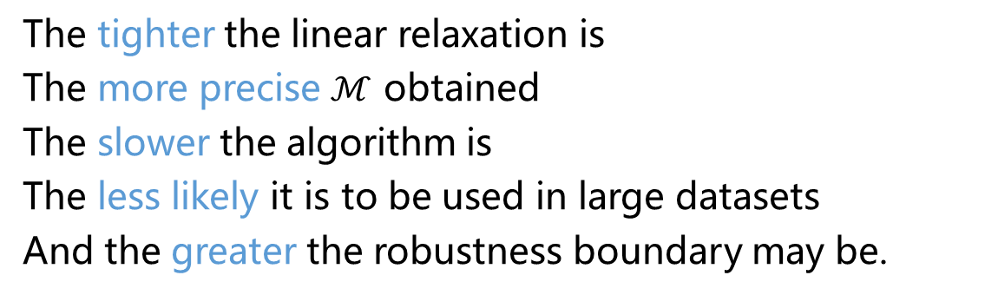
Summary
The tighter the linear relaxation is
The more precise $ℳ$ obtained
The slower the algorithm is
The less likely it is to be used in large datasets
And the greater the robustness boundary may be.

